Slide 1
Discovering Multi-Word “Concepts” by Statistical Analysis
- multi-terms and terminology -
COMP 336 Dik Lun LEE Department of Computer Science, HKUST, Slide <number>

Slide 2
Collocations
Collocation analysis reveals word usage patterns in a language
Two or more words are collocated if they are used together conventionally, i.e., why they are used together is not easily explainable
  Noun phrases: “strong tea” and “powerful machines”
  Phrasal verbs: “make up”
  Stock (recurring and commonplace) phrases: “the rich and famous”
Reveals words that are often used by people (sentiment analysis)
  “Toyota” is often used with “reliable” or “dependable”
  “stock market” is often used with “high” in the past week
  “government” is often used with “trust-worthy”, “efficient”, etc.
COMP 336 Dik Lun LEE Department of Computer Science, HKUST, Slide <number>

Slide 3
Counting Raw Frequencies
Counting the frequencies of bigrams (two consecutive terms), and retain bigrams with high frequencies
However, in terms of finding contents, it is not very useful
C(w1,w2) | w1 | w2
80871 | of | the
58841 | in | the
26430 | to | the
21842 | on | the
… | … | …
12622 | from | the
11428 | new | york
10007 | he | said
9775 | as | a
Removing all stopwords may remove some meaningful phrases: compare indexing and searching
COMP 336 Dik Lun LEE Department of Computer Science, HKUST, Slide <number>

Slide 4
Filtered by Grammatical Patterns
Not all patterns are useful; only consider:
  A: Adjective; P: preposition; N: noun
Retain the following useful grammatical patterns:
Grammatical Patterns | Examples
A N | relational database
N N | database system
A A N | distributed computing system
A N N | distributed database system
N A N | mean squared error
N N N | management information system
N P N | degrees of freedom
COMP 336 Dik Lun LEE Department of Computer Science, HKUST, Slide <number>

Slide 5
Filtered by Grammatical Patterns
C(w1,w2) | w1 | w2 | Pattern
11487 | new | york | A N
7261 | united | states | A N
5412 | los | angeles | N N
3301 | last | year | A N
3191 | saudi | arabia | N N
2699 | last | week | A N
2514 | vice | president | A N
… | … | … | …
1328 | oil | prices | N N
1210 | next | year | A N
1074 | chief | executive | A N
1073 | real | estate | A N
Compositional collocation: meaning can be predicted from its parts
Non-compositional collocation: meaning cannot be predicted from its parts
(Note: NN pairs)
COMP 336 Dik Lun LEE Department of Computer Science, HKUST, Slide <number>

Slide 6
Collocation and Co-occurrence
Word sequences will miss different sequences with identical meaning
  dual core CPUs vs CPUs with dual core
  dik lee vs dik lun lee vs lee dik lun
  distributed systems vs distributed and reliable systems
Solution: Count how often two words appears in the same text, e.g., in the same sentence, same paragraph, same document, or simply in a window of certain length
Collocation vs co-occurrence
  Collocation is commonly used in natural language processing, more concerned with where the words appear
  Co-occurrence is more used in IR with less emphasis on the locations of the words but a window can be applied
  We use these two terms inter-exchangeably
COMP 336 Dik Lun LEE Department of Computer Science, HKUST, Slide <number>

Slide 7
Distance between Words
Co-occurred terms: terms that occur frequently in the same document
Collocation Window: terms that occur frequently in the same window (say, 10 – 20 words)
Distance between two words is the number of words between them plus one
Distance is directional: distance(x, y) = - distance(y, x)
  she knocked on his door
  they knocked at the door
  100 women knocked on Donaldson ’ s door
  a man knocked on the metal front door
d(knock, door) = 3, 3, 5, 5 in the above windows
Direction matters: d(knock, door) = -2 in “the door was knocked”
counted as 3 words
COMP 336 Dik Lun LEE Department of Computer Science, HKUST, Slide <number>

Slide 8
A Lot can be Learnt
 |  |  | Distance
Relation | Word x | Word y | Mean | Variance
Fixed | bread | butter | 2.00 | 0.00
 | drink | drive | 2.00 | 0.00
Compound | computer | scientist | 1.12 | 0.10
 | United | States | 0.98 | 0.14
Semantic | man | woman | 1.46 | 8.07
 | man | women | -0.12 | 13.08
Lexical | refraining | from | 1.11 | 0.20
 | coming | from | 0.83 | 2.89
 | keeping | from | 2.14 | 5.53
compare
COMP 336 Dik Lun LEE Department of Computer Science, HKUST, Slide <number>

Slide 9
Mutual Information (MI)
Raw frequencies do not tell the true picture
Suppose:
  “Toyota” and “durability” appear together 1,000 times
  “Volvo” and “safety” appear together 50 times
Conclusion: Durability is important for Toyota, but safety is NOT important for Volvo
Is the conclusion correct?
COMP 336 Dik Lun LEE Department of Computer Science, HKUST, Slide <number>

Slide 10
Mutual Information (MI)
The conclusion could be wrong
Toyota is a much more popular than Volvo, people mention about Toyota more often than Volvo (e.g., Toyota could be frequently mentioned together with “fuel efficiency”, “low-price”, “maneuverability”, etc.
Suppose Toyota is mentioned 10,000 times but Volvo is mentioned only 150 times
What would be the conclusion?
COMP 336 Dik Lun LEE Department of Computer Science, HKUST, Slide <number>

Slide 11
Mutual Information (MI)
Mutual Information considers both co-occurrence frequencies and frequencies of individual terms
Co-occurrence frequency is normalized by the individual frequencies
How is it done?
COMP 336 Dik Lun LEE Department of Computer Science, HKUST, Slide <number>

Slide 12
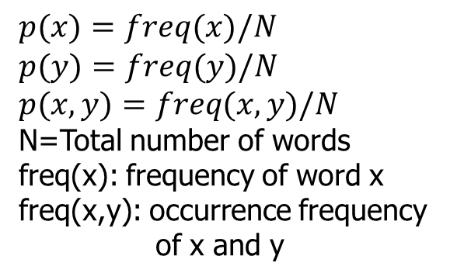
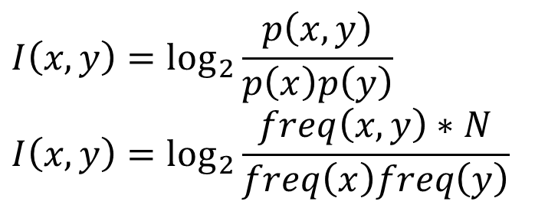
Mutual Information (MI)
Given a dice, the probability of a number x to be drawn is p(x)=1/6
The probability of two numbers x and y to be drawn in two tosses is p(x,y)=1/36
I(x,y) = log2 (1/36) / [(1/6)(1/6)] = 0
x and y are random; x and y co-occur purely by chance
If x and y appear together more than “random”, I is positive
If x and y appear together less than “random”, I is negative
COMP 336 Dik Lun LEE Department of Computer Science, HKUST, Slide <number>

Slide 13
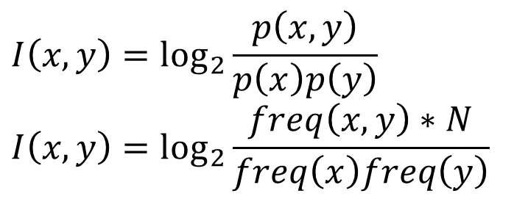
Mutual Information (MI)
… computer system ... computer … system … computer system … system … system … system
Suppose N=1000
p(computer) = 3 / 1000 p(system) = 6 / 1000
Window size = 2
p(computer system) = 2 / (1000)
I(computer system) = log₂ ( 2*1000 / (3 * 6) ) = 6.8
COMP 336 Dik Lun LEE Department of Computer Science, HKUST, Slide <number>

Slide 14
Mutual Information (MI)
N=50000
freq(toyota, durability)=1000; freq(toyota)=10000, freq(durability)=500
I(toyota, durability) = log2 (1000 * 50000 /(10000*500)) = 3.32
freq(volvo, safety)=50; freq(volvo)=150; freq(safety)=1000
I(volva, safety) = log2 (50*50000/(150*1000)) =4.06
So, the association between volvo and safety is higher than that of toyota and durability.
COMP 336 Dik Lun LEE Department of Computer Science, HKUST, Slide <number>

Slide 15
Examples
1987 Associate Press corpus with N=15,000,000
Window size = 5
log₂ (12*15000000)/(111*621)
I(x,y) | f(x,y) | f(x) | x | f(y) | y
11.3 | 12 | 111 | honorary | 621 | doctor
11.3 | 8 | 1105 | doctors | 44 | dentists
10.7 | 30 | 1105 | doctors | 241 | nurses
I(x,y) | f(x,y) | f(x) | x | f(y) | y
0.96 | 6 | 621 | doctor | 73785 | with
0.95 | 41 | 284690 | a | 1105 | doctors
0.93 | 12 | 84716 | is | 1105 | doctors
COMP 336 Dik Lun LEE Department of Computer Science, HKUST, Slide <number>

Slide 16
Strong vs Powerful
Strong tea vs powerful tea ?
I(x,y) | f(x,y) | f(x) | x | f(y) | y
10.47 | 7 | 7809 | strong | 23 | northerly
9.76 | 23 | 7809 | strong | 151 | showings
9.30 | 7 | 7809 | strong | 63 | believer
8.66 | 7 | 1984 | powerful | 388 | legacy
8.58 | 7 | 1984 | powerful | 410 | tool
8.35 | 8 | 1984 | powerful | 548 | storm
COMP 336 Dik Lun LEE Department of Computer Science, HKUST, Slide <number>

Slide 17
Revealing Real World Knowledge
What does a boat do?
I(x,y) | f(x,y) | f(x) | x | f(y) | y
11.01 | 16 | 984 | boat | 194 | capsize
9.30 | 51 | 984 | boat | 2036 | sink
8.17 | 3 | 984 | boat | 262 | cruise
7.40 | 6 | 984 | boat | 890 | sail
… | … | … | … | … | …
1.26 | 3 | 984 | boat | 31506 | become
0.94 | 19 | 984 | boat | 247542 | have
… | … | … | … | … | …
-0.35 | 3 | 984 | boat | 95880 | make
-3.38 | 84 | 984 | boat | 1045494 | say
COMP 336 Dik Lun LEE Department of Computer Science, HKUST, Slide <number>

Slide 18
Applications in Search Engine
Suppose A and B co-occur frequently in a collection, we can do …
Query suggestion: When user searches A, suggest B
Reinforcing page ranking: When user searches A, pages containing both A and B are given a bonus compared to pages that contain only A
Fight spam pages:
  Spam pages are pages contain a large number of popular terms but the page is not on any of the topics
  A page is required to contain a certain number of terms associated with the query, or it would be ranked very low
Identify page topic: Identify the feature terms of a topic, pages containing certain number of the terms are assigned to that topic
COMP 336 Dik Lun LEE Department of Computer Science, HKUST, Slide <number>

